Slide 1
Stochastic demographic population modelling

Slide 2
Aims
Understand what deterministic and stochastic modelling are
Be able to build stochastic models based on given parameters
Appreciate the added complexity of drawing from random distributions rather than applying rates and averages
Be able to run stochastic simulations on a cluster
Be able to process and visualise stochastic simulations
Appreciate where deterministic and stochastic modelling substantially differ

Slide 3
Stochastic vs deterministic modelling
Deterministic = determined
Assumes that outcomes follow determined paths
Can be simulated once to observe modelled behaviour
Stochastic = random
Assumes that outcomes are drawn from random distributions
Must be simulated many times to observe modelled behaviour, since every simulation can be different
Typically closer to reality as life is inherently random!

Slide 4
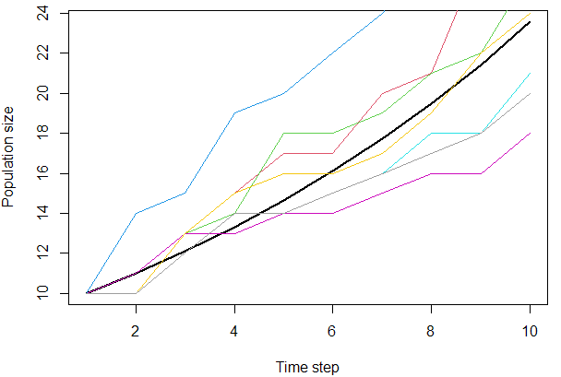
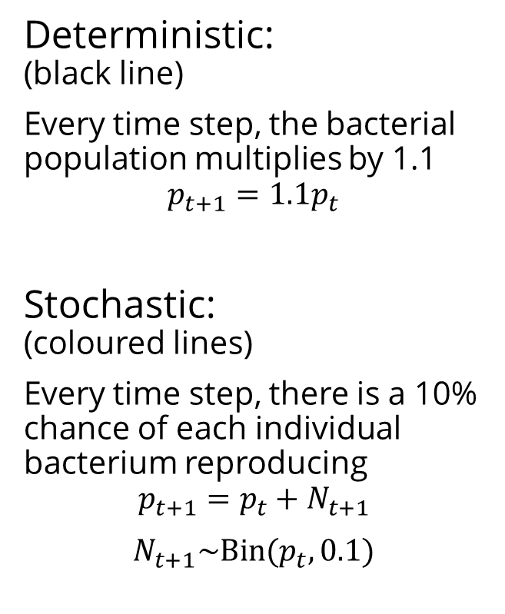
Example: Exponential population model
Deterministic: (black line)
Every time step, the bacterial population multiplies by 1.1
$$p_{t+1}=1.1p_{t}$$
Stochastic: (coloured lines)
Every time step, there is a 10% chance of each individual bacterium reproducing
$$p_{t+1}=p_{t}+N_{t+1}$$
$$N_{t+1}\sim Bin(p_{t},0.1)$$

Slide 5
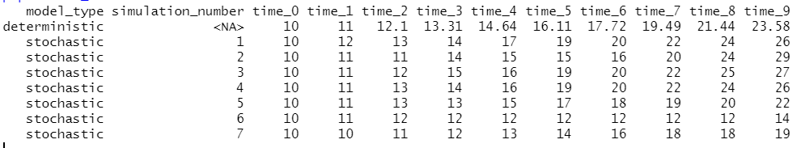
Example: Exponential population model
Note that the deterministic simulation is based on averages and therefore results in continuous – not discrete – outputs
If we were modelling number of bacteria, this would be biologically unrealistic
In this particular situation, the deterministic simulations reflects the average behaviour of the stochastic model

Slide 6
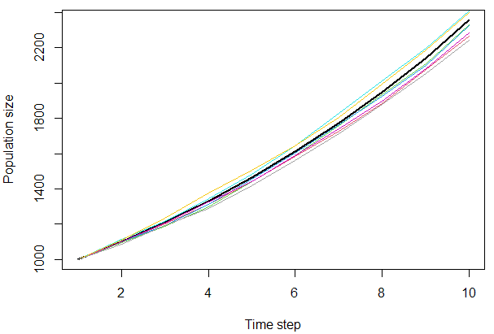
Example: Exponential population model
In some situations, deterministic and stochastic modelling may produce very similar outcomes – the deterministic model is a good approximation to the stochastic model.
E.g., in this example the initial population size was set at 1000 rather than the previous value of 10.

Slide 7
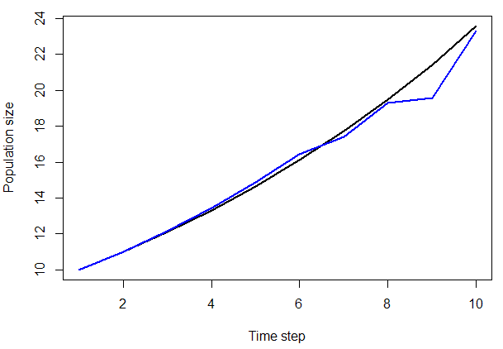
Example: Exponential population model
In some situations, the deterministic model reflects the average behaviour of the stochastic model.
E.g., the blue line in this plot shows the average population size at each time point across the 7 stochastic simulations (with initial population size of 10) (the black line is still the deterministic simulation)

Slide 8
Stochastic modelling
Enables us to include realistic probability distributions (rather than assuming that everything follows the “average” outcome)
Can enable us to handle discrete outcomes
E.g., whole number of organisms; not 16.11 bacteria
Most important in situations where:
Stochastic events can make a substantial difference
Future changes are sensitive to the current value
Should be run many times in order to get an overall sense of model behaviour – this is where cluster computing can be useful
Can present a trade-off: biological realism vs computational effort

Slide 9
Demographic population models
A demographic population model describes how a population changes in terms of, and in response to, a demographic structure in the population.
The demographic structure would typically be a set of traits which affect life history processes (i.e., birth and death).
A simple demographic trait to structure a population model is age
Other traits could include body weight, sex, or sexual maturity
Demographic population models can also incorporate evolutionary processes (“evolutionary demography”) which have been used to explore evolution of life history “strategies”

Slide 10
Matrix population models
The term matrix population model usually refers to an age- or stage-structured matrix population model
In this format, a population is divided into discrete life stages or age classes
Each stage/class has a set of parameters to describe demographic processes (i.e., survival, maturation, and recruitment)
The population is represented by a state vector containing the number of individuals in each stage/class
The parameters are put into a projection matrix which can be applied to the state vector to project the population forwards in time
Matrix population models are typically deterministic

Slide 11


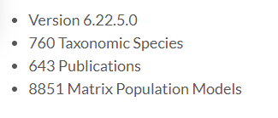
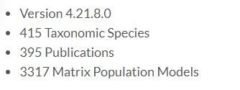
Matrix population models
Allows us to model population dynamics, which are hard to observe, based on individual-level processes, which are easier to observe
The parameters can be inferred by field studies such as capture-mark-recapture
Online database of matrices, so there is field-based evidence to support the modelling of many different populations

Slide 12



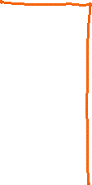









Matrix multiplication

Slide 13






Matrix population models
In a deterministic application of a matrix population model, we assume that population changes will follow the “average” (which are the parameters in the projection matrix)
We can compute these changes by multiplying the state vector by the projection matrix using matrix multiplication

Slide 14









Matrix population models
In a deterministic application of a matrix population model, we assume that population changes will follow the “average” (which are the parameters in the projection matrix)
We can compute these changes by multiplying the state vector by the projection matrix using matrix multiplication

Slide 15




Matrix population models
In a deterministic application of a matrix population model, we assume that population changes will follow the “average” (which are the parameters in the projection matrix)
We can compute these changes by multiplying the state vector by the projection matrix using matrix multiplication

Slide 16




Matrix population models
In a deterministic application of a matrix population model, we assume that population changes will follow the “average” (which are the parameters in the projection matrix)
We can compute these changes by multiplying the state vector by the projection matrix using matrix multiplication

Slide 17
Matrix population models
The matrix formulation is helpful because there are some mathematical shortcuts we can use:
e.g. an eigenvector of
Limitations:
random outcomes such as random extinction cannot occur
technically the population state can never reach zero (it can only get closer and closer to zero) so we would have to define a threshold for extinction if we were modelling this

Slide 18
Matrix population models – no extinction?
The projection matrix used here is making the population smaller and smaller, but the population size actually never reaches zero.

Slide 19
Stochastic version
As discussed already, deterministic models do not always reflect reality
We will carry out the same kind of age-structured population model except this time we will not assume determinism – processes will be stochastic
This will allow us to compare the deterministic and stochastic equivalents
How can we convert biological parameters inferred from field studies into a stochastic formulation?
Think about every process involved/assumed in the model and what probability distribution it is drawn from

Slide 20
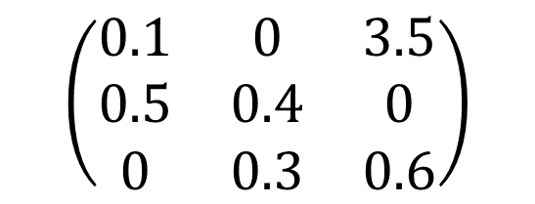
Making a deterministic matrix population model stochastic: Survival and maturation
Suppose there are 10 individuals in stage 2. The projection matrix tells us that at the next time step we expect a proportion 0.4 to stay in stage 2, and we expect a proportion 0.3 to have matured into stage 3. (We expect the remaining proportion 0.3 to have died.)
$$\left(\begin{matrix}0.1 & 0 & 3.5 \\ 0.5 & 0.4 & 0 \\ 0 & 0.3 & 0.6\end{matrix}\right)$$
4
stay
3
mature
10
Expectation:
3
die

Slide 21
Making a deterministic matrix population model stochastic: Survival and maturation
Suppose there are 10 individuals in stage 2. The projection matrix tells us that at the next time step we expect a proportion 0.4 to still be in stage 2, and we expect a proportion 0.3 to have matured into stage 3. (We expect the remaining proportion 0.3 to have died.)
In a stochastic formulation, we consider the probability of each of these three events (staying in the same life stage, maturing into the next life stage, and death) for every individual.
$$\left(\begin{matrix}0.1 & 0 & 3.5 \\ 0.5 & 0.4 & 0 \\ 0 & 0.3 & 0.6\end{matrix}\right)$$
?
stay
?
mature
10
?
die
Notes:
Binominals Distribution

Slide 22
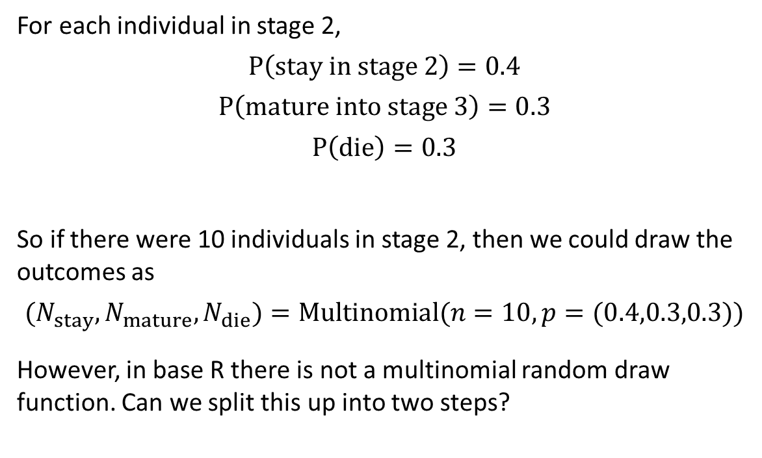
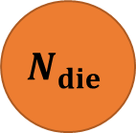
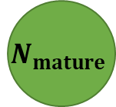

Making a deterministic matrix population model stochastic: Survival and maturation
$$N_{stay}$$
For each individual in stage 2,
$$P\left(stay in stage 2\right)=0.4$$
$$P\left(mature into stage 3\right)=0.3$$
$$P\left(die\right)=0.3$$
So if there were 10 individuals in stage 2, then we could draw the outcomes as
$${(N}_{stay},N_{mature},N_{die})=Multinomial(n=10, p=(0.4,0.3,0.3))$$
However, in base R there is not a multinomial random draw function. Can we split this up into two steps?
$$N_{mature}$$
10
$$N_{die}$$

Slide 23
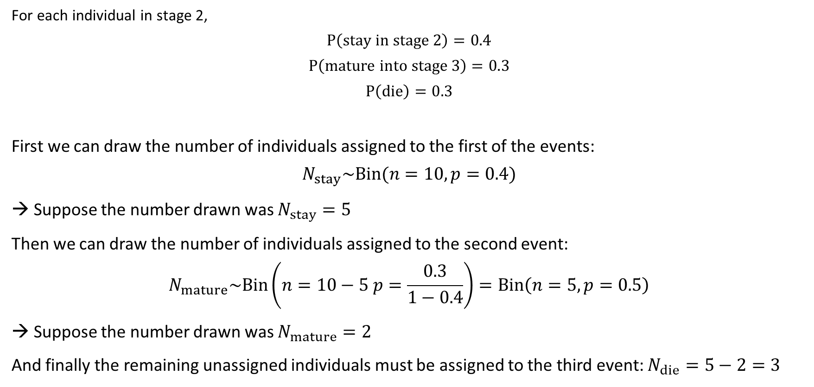
Making a deterministic matrix population model stochastic: Survival and maturation & multinomial random draw
For each individual in stage 2,
$$P\left(stay in stage 2\right)=0.4$$
$$P\left(mature into stage 3\right)=0.3$$
$$P\left(die\right)=0.3$$
First we can draw the number of individuals assigned to the first of the events:
$$N_{stay}\sim Bin(n=10, p=0.4)$$
→ Suppose the number drawn was $N_{stay}=5$
Then we can draw the number of individuals assigned to the second event:
$$N_{mature}\sim Bin\left(n=10−5 p=\frac{0.3}{1−0.4}\right)=Bin\left(n=5, p=0.5\right)$$
→ Suppose the number drawn was $N_{mature}=2$
And finally the remaining unassigned individuals must be assigned to the third event: $N_{die}=5−2=3$
stay
0.4
mature
0.3
die
0.3

Slide 24
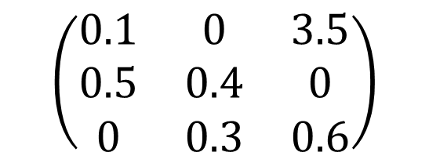

Making a deterministic matrix population model stochastic: Survival and maturation – applying to all life stages
$$\left(\begin{matrix}0.1 & 0 & 3.5 \\ 0.5 & 0.4 & 0 \\ 0 & 0.3 & 0.6\end{matrix}\right)$$
When looking at life stage 1, we need to find out $N_{stay}$ and $N_{mature}$ for this stage. These will correspond to stage 1 and stage 2 respectively. Suppose that for life stage 1, $N_{stay}=5$ and $N_{mature}=27$.

Slide 25

Making a deterministic matrix population model stochastic: Survival and maturation – applying to all life stages
$$\left(\begin{matrix}0.1 & 0 & 3.5 \\ 0.5 & 0.4 & 0 \\ 0 & 0.3 & 0.6\end{matrix}\right)$$
When looking at life stage 1, we need to find out $N_{stay}$ and $N_{mature}$ for this stage. These will correspond to stage 1 and stage 2 respectively. Suppose that for life stage 1, $N_{stay}=5$ and $N_{mature}=27$.
We need to do the same for life stage 2. Suppose that $N_{stay}=10$and $N_{mature}=8$.

Slide 26
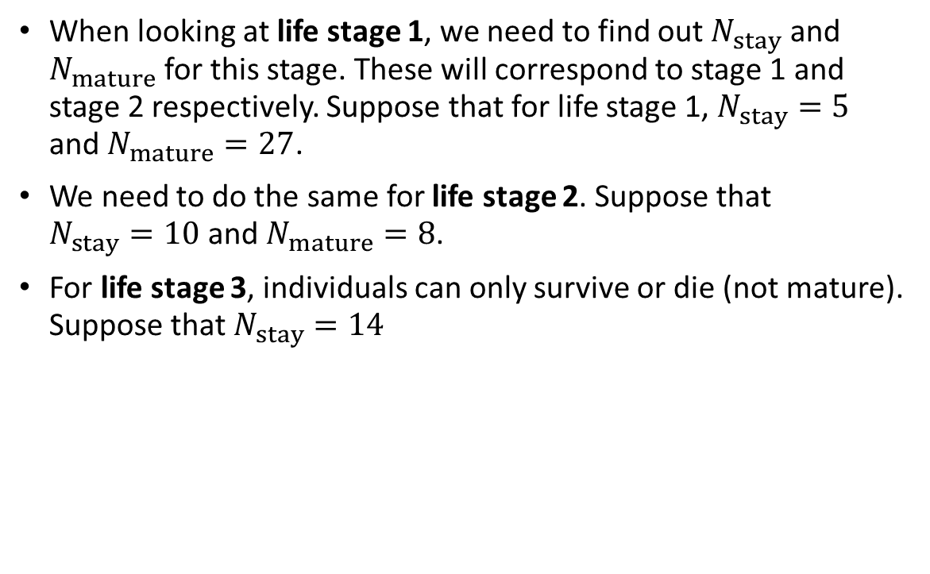
Making a deterministic matrix population model stochastic: Survival and maturation – applying to all life stages
$$\left(\begin{matrix}0.1 & 0 & 3.5 \\ 0.5 & 0.4 & 0 \\ 0 & 0.3 & 0.6\end{matrix}\right)$$
When looking at life stage 1, we need to find out $N_{stay}$ and $N_{mature}$ for this stage. These will correspond to stage 1 and stage 2 respectively. Suppose that for life stage 1, $N_{stay}=5$ and $N_{mature}=27$.
We need to do the same for life stage 2. Suppose that $N_{stay}=10$and $N_{mature}=8$.
For life stage 3, individuals can only survive or die (not mature). Suppose that $N_{stay}=14$

Slide 27

Making a deterministic matrix population model stochastic: Survival and maturation – applying to all life stages
$$\left(\begin{matrix}0.1 & 0 & 3.5 \\ 0.5 & 0.4 & 0 \\ 0 & 0.3 & 0.6\end{matrix}\right)$$
When looking at life stage 1, we need to find out $N_{stay}$ and $N_{mature}$ for this stage. These will correspond to stage 1 and stage 2 respectively. Suppose that for life stage 1, $N_{stay}=5$ and $N_{mature}=27$.
We need to do the same for life stage 2. Suppose that $N_{stay}=10$and $N_{mature}=8$.
For life stage 3, individuals can only survive or die (not mature). Suppose that $N_{stay}=14$
$$\left(\begin{matrix}5 \\ 27+10 \\ 8+14\end{matrix}\right)$$
Then to obtain the population state at the next time step, we need to add these together in the correct entries of the life state vector:
But this doesn’t include recruitment – we ignored the 3.5 entry of the vector since this did not reflect survival or maturation.

Slide 28
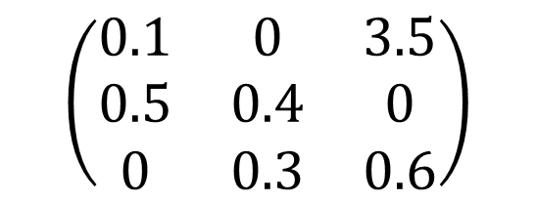
Making a deterministic matrix population model stochastic: Recruitment
$$\left(\begin{matrix}0.1 & 0 & 3.5 \\ 0.5 & 0.4 & 0 \\ 0 & 0.3 & 0.6\end{matrix}\right)$$
Suppose there are 5 individuals in stage 3. The projection matrix tells us that at the next time step we expect each individual to have recruiting 3.5 new offspring, which will be in stage 1.
17.5
5
Expectation:
offspring

Slide 29
Making a deterministic matrix population model stochastic: Recruitment
$$\left(\begin{matrix}0.1 & 0 & 3.5 \\ 0.5 & 0.4 & 0 \\ 0 & 0.3 & 0.6\end{matrix}\right)$$
Suppose there are 5 individuals in stage 2. The projection matrix tells us that at the next time step we expect each individual to have recruiting 3.5 new offspring.
In a stochastic formulation, we consider the probability of each individual recruiting (either they recruit or they don’t) and also the probability of the litter/clutch size taking different values.
?
recruiting adults
5
?
offspring

Slide 30
Making a deterministic matrix population model stochastic: Recruitment
$$\left(\begin{matrix}0.1 & 0 & 3.5 \\ 0.5 & 0.4 & 0 \\ 0 & 0.3 & 0.6\end{matrix}\right)$$
We have a problem here because the probability of a given adult recruiting and the probability of each clutch/litter size taking different values have been conflated into one value, 3.5, which is the “recruitment rate”.
We need to separately know the recruitment probability and the probability distribution for clutch/litter size.
?
recruiting adults
5
?
offspring

Slide 31
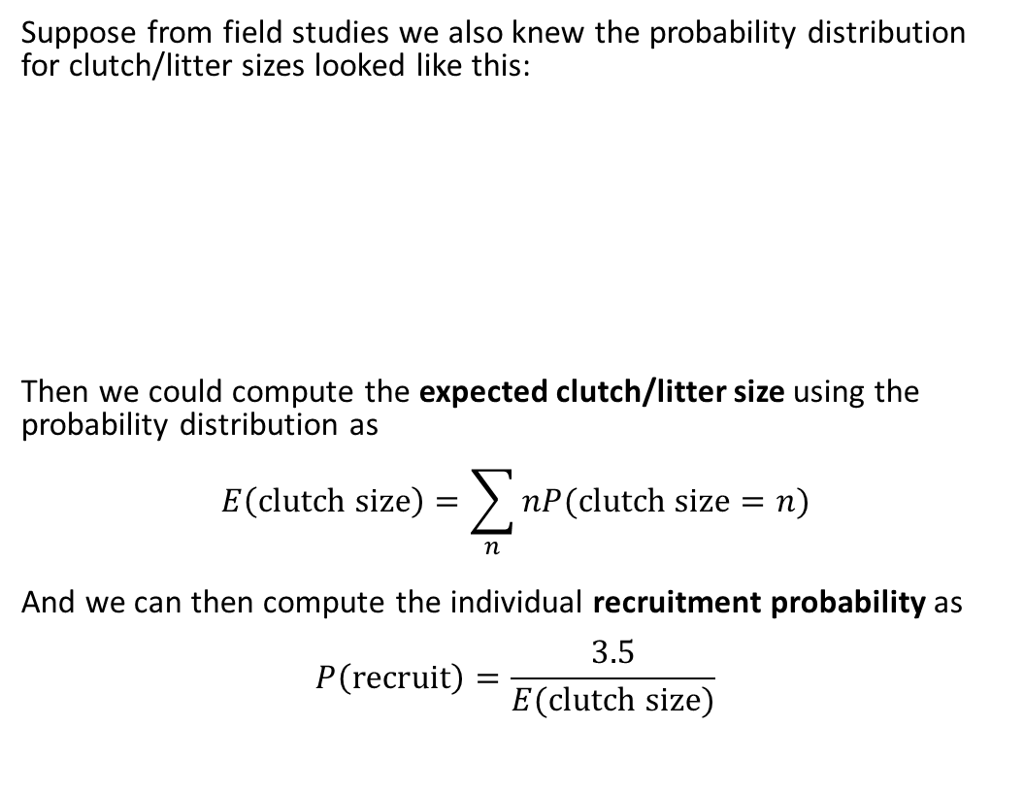
Making a deterministic matrix population model stochastic: Recruitment
$$\left(\begin{matrix}0.1 & 0 & 3.5 \\ 0.5 & 0.4 & 0 \\ 0 & 0.3 & 0.6\end{matrix}\right)$$
Suppose from field studies we also knew the probability distribution for clutch/litter sizes looked like this:
Then we could compute the expected clutch/litter size using the probability distribution as
$$E\left(clutch size\right)=\sum_{n}{nP(clutch size=n)}$$
And we can then compute the individual recruitment probability as
$$P\left(recruit\right)=\frac{3.5}{E(clutch size)}$$
?
recruiting adults
5
?
offspring

Slide 32
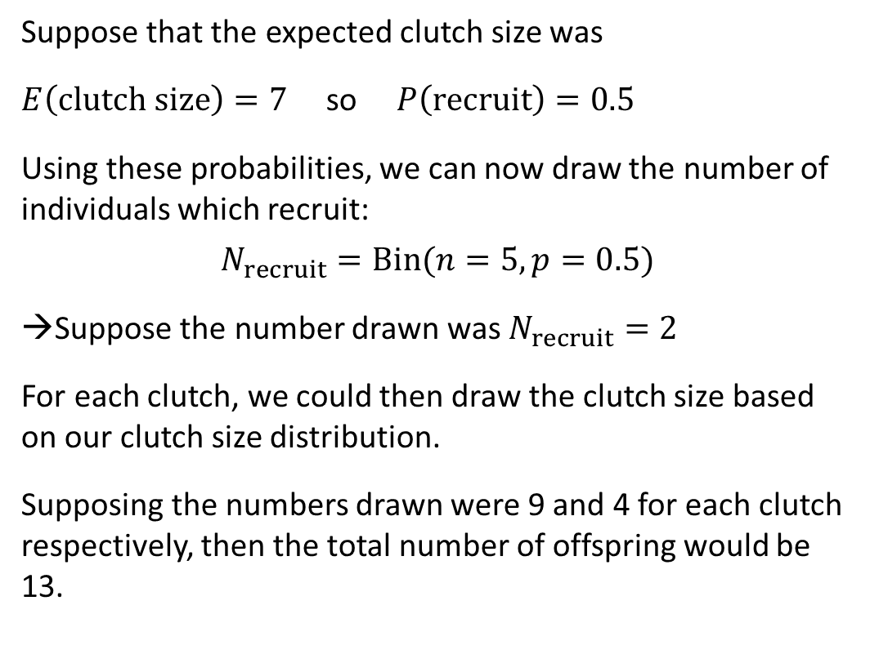
Making a deterministic matrix population model stochastic: Recruitment
5
Suppose that the expected clutch size was
$E\left(clutch size\right)=7$ so $P\left(recruit\right)=0.5$
Using these probabilities, we can now draw the number of individuals which recruit:
$$N_{recruit}=Bin(n=5,p=0.5)$$
Suppose the number drawn was $N_{recruit}=2$
For each clutch, we could then draw the clutch size based on our clutch size distribution.
Supposing the numbers drawn were 9 and 4 for each clutch respectively, then the total number of offspring would be 13.
2
recruiting adults
4
9
offspring
offspring

Slide 33
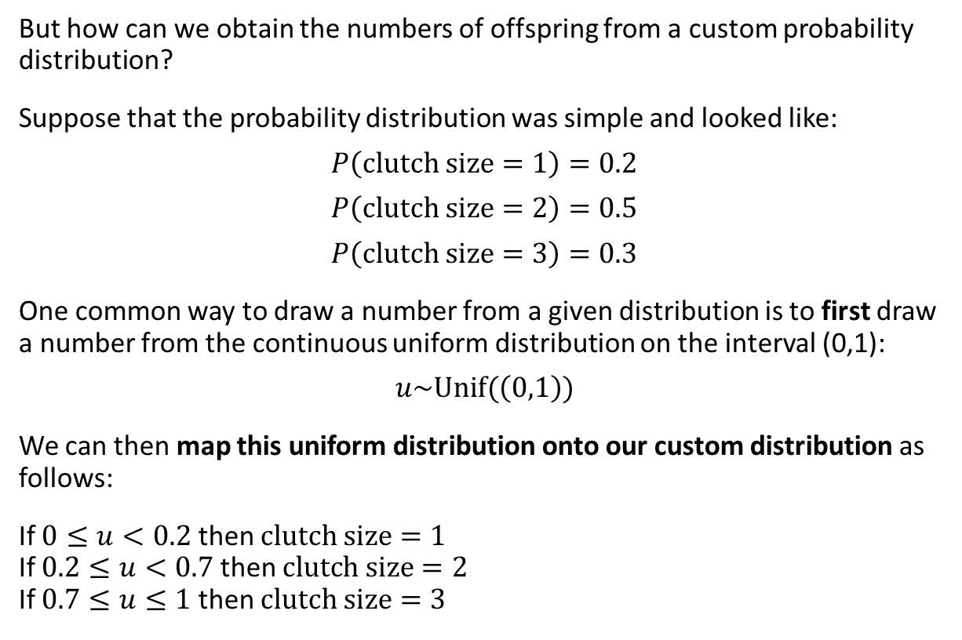
Making a deterministic matrix population model stochastic: Recruitment & drawing from a distribution
5
But how can we obtain the numbers of offspring from a custom probability distribution?
Suppose that the probability distribution was simple and looked like:
$$P\left(clutch size=1\right)=0.2$$
$$P\left(clutch size=2\right)=0.5$$
$$P\left(clutch size=3\right)=0.3$$
One common way to draw a number from a given distribution is to first draw a number from the continuous uniform distribution on the interval (0,1):
$$u\sim Unif(\left(0,1\right))$$
We can then map this uniform distribution onto our custom distribution as follows:
If $0≤u<0.2$ then $clutch size=1$ If $0.2≤u<0.7$ then $clutch size=2$ If $0.7≤u≤1$ then $clutch size=3$
2
recruiting adults
?
?
Because each interval width is equal to the corresponding probability in our distribution, we get the correct event probabilities.
offspring
offspring

Slide 34
Making a deterministic matrix population model stochastic: Applying processes in turn – common mistakes
One of the challenges with applying a stochastic simulation is that different processes have to be applied one-by-one, which seems counterintuitive since in a deterministic model everything happens at the same time.
It is important not to make these mistakes with our stochastic application of a matrix population model:
Apply survival and maturation and find out what the new population looks like after these processes
Apply recruitment and find out how many offspring this new population recruits, then add them into the population
Or alternatively
Apply recruitment and find out how many offspring are produced, then add them into the population
Apply survival and maturation to the new population including the new offspring
We have to be careful to avoid these mistakes as they effectively jump ahead and make the processes occur more quickly than they should.

Slide 35
Making a deterministic matrix population model stochastic: Applying processes in turn
One of the challenges with applying a stochastic simulation is that different processes have to be applied one-by-one, which seems counterintuitive since in a deterministic model everything happens at the same time.
current population
offspring produced by current population
current population after maturation and recruitment applied
+
=
new population

Slide 36
The resulting model – a stochastic demographic population model
Stochastic because processes are drawn from random distributions
Demographic because the population is structured by life stage (a demographic trait)
Pros:
In general, it is a better reflection of reality than the deterministic model (as long as we run it many times to observe outcomes)
We can observe random extinction and the population can reach zero, so we can compute extinction probability
Cons:
It needs to be run many times to see a representative sample of outcomes
It was more awkward to code than the deterministic matrix population model
It required additional data to simulate correctly (clutch size distribution)

